Slide 1

2018 Peanut Weed
Control Update
Eric P. Prostko
Extension Weed Specialist
Department of Crop & Soil Sciences

Slide 2
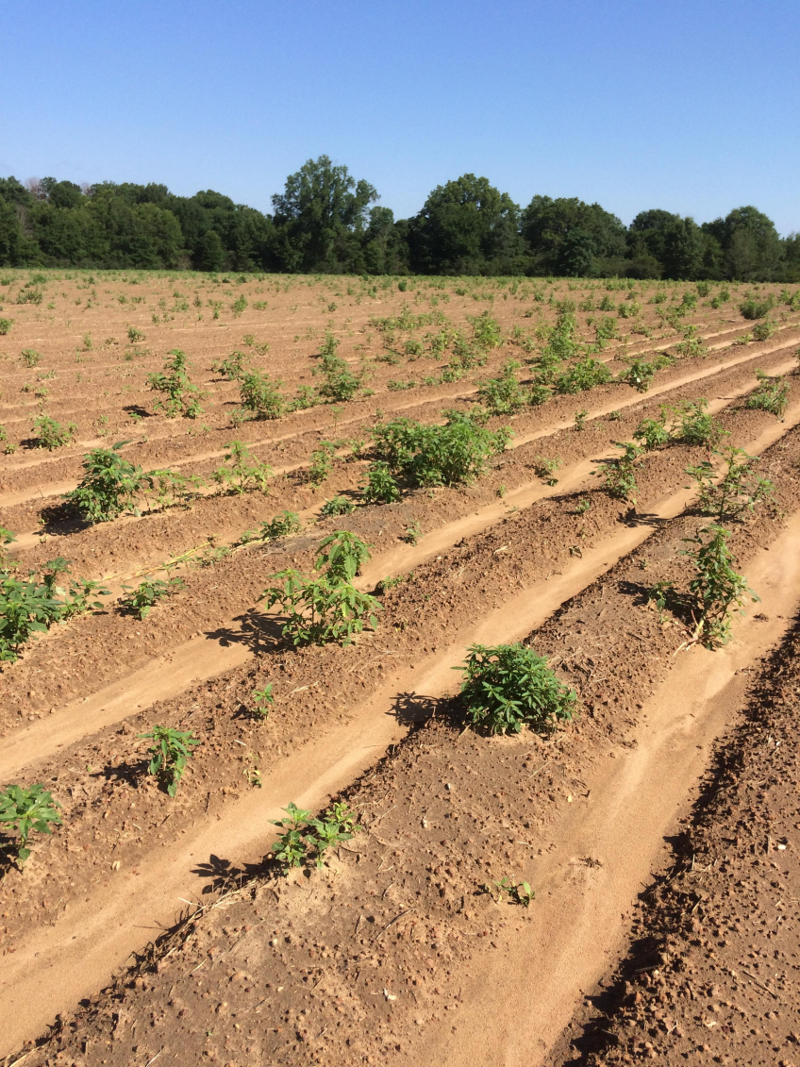
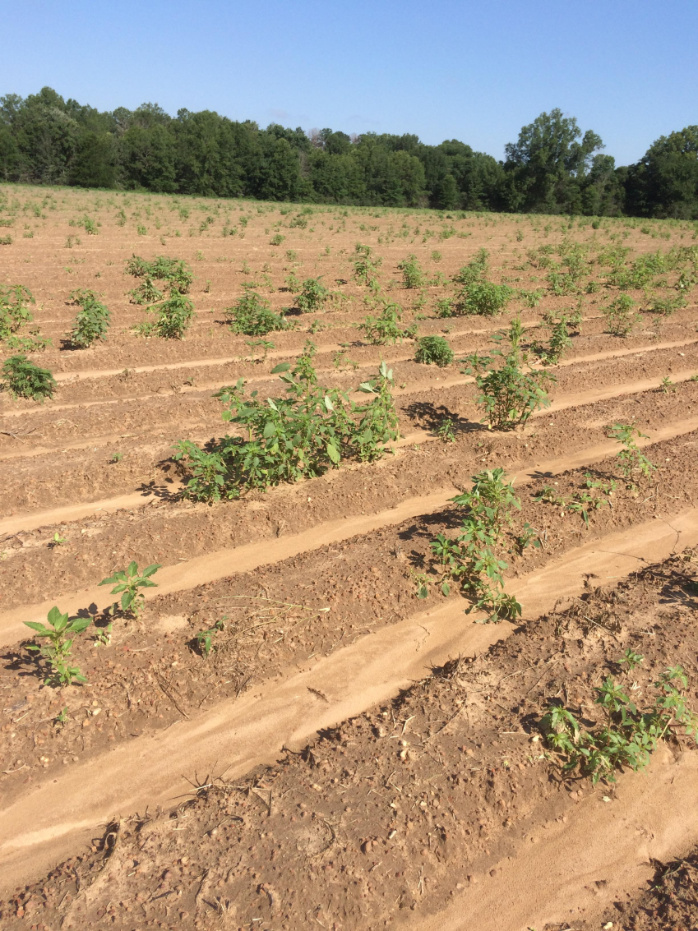
Not a good way to start out!

Slide 3
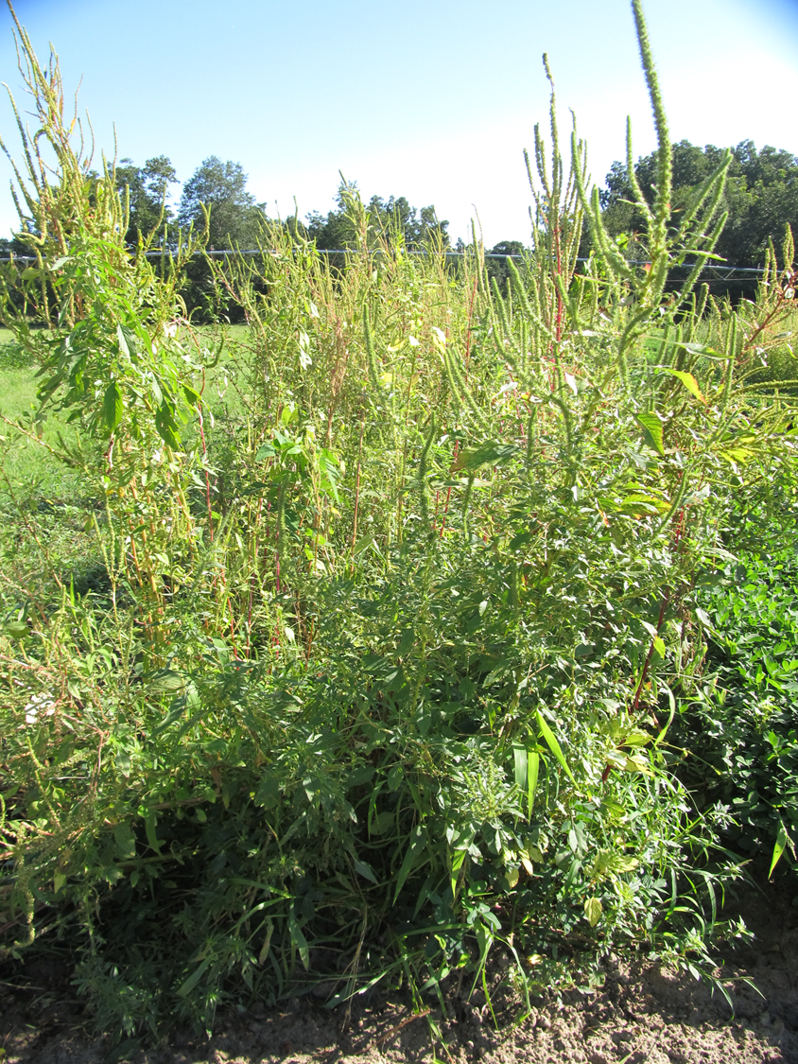
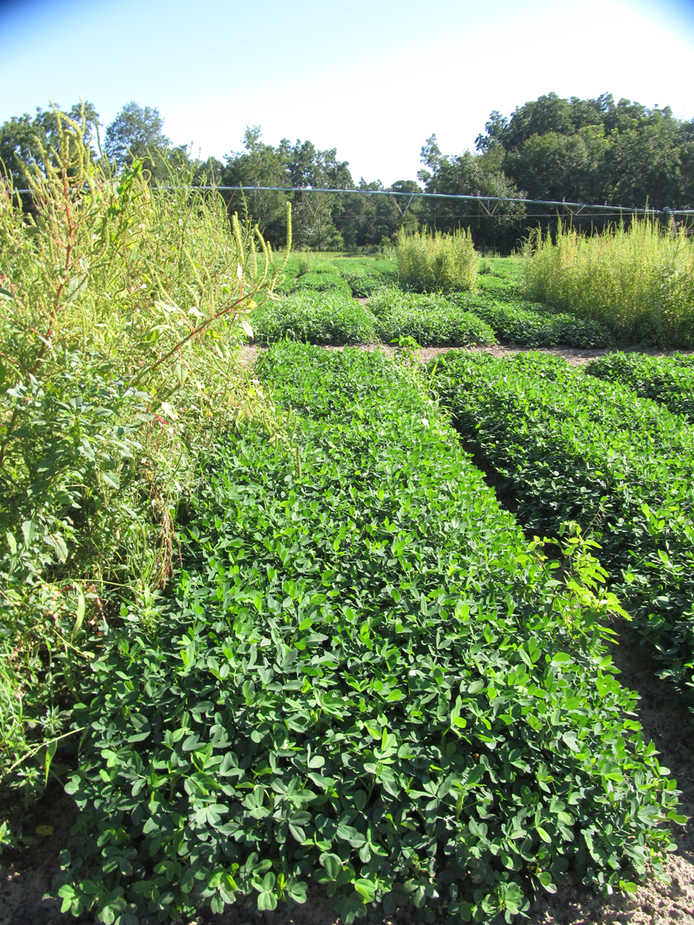
Peanut Weed Control – 2017
Valor/Cadre Program
NTC
Prowl H₂0 3.8CS @ 32 oz/A (PRE)
Valor SX 51WG @ 3 oz/A (PRE)
Strongarm 84WG @ 0.225 oz/A (PRE)
Cadre 2AS @ 4 oz/A (38 DAP)
2,4-DB 1.75SL @ 18 oz/A (38 DAP)
Dual Magnum 7.62EC @ 16 oz/A (38 DAP)
PE-19-17
July 31
84 DAP

Slide 4
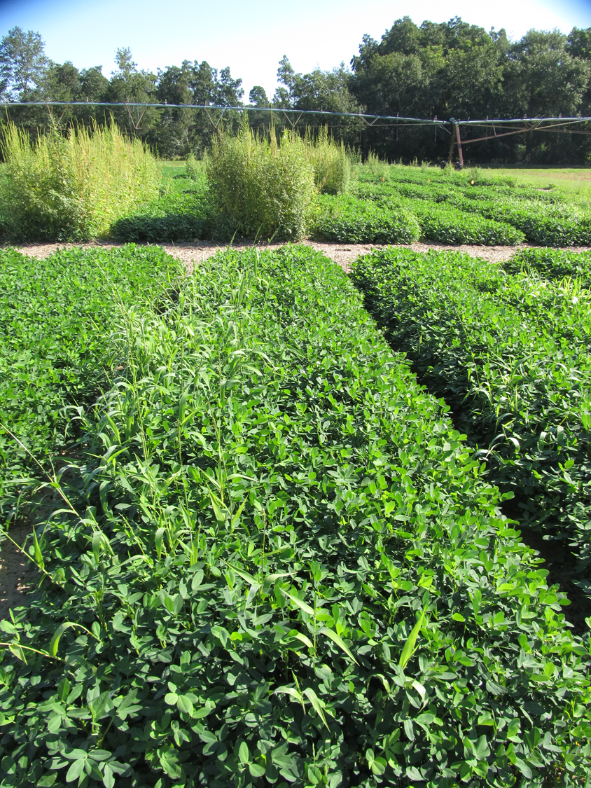
Peanut Weed Control – 2017
Valor/Cobra Program
NTC
Prowl H₂0 3.8CS @ 32 oz/A (PRE)
Valor SX 51WG @ 3 oz/A (PRE)
Strongarm 84WG @ 0.225 oz/A (PRE)
Cobra 2EC @ 12.5 oz/A (38 DAP)
2,4-DB 1.75SL @ 18 oz/A (38 DAP)
Dual Magnum 7.62EC @ 16 oz/A (38 DAP)
PE-19-17
July 31
84 DAP

Slide 5
Rainfall Totals - May 20-May 24, 2017
Source: UGA Automated Weather Network

Slide 6
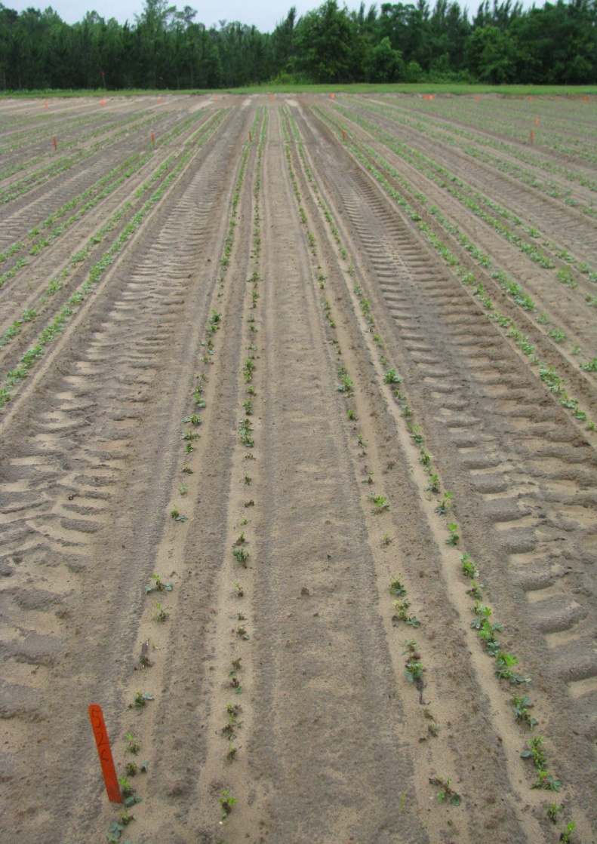
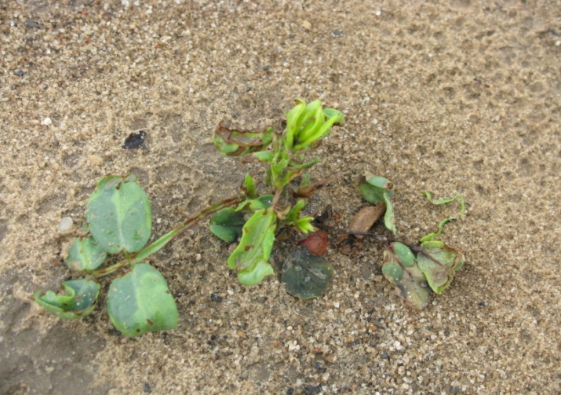
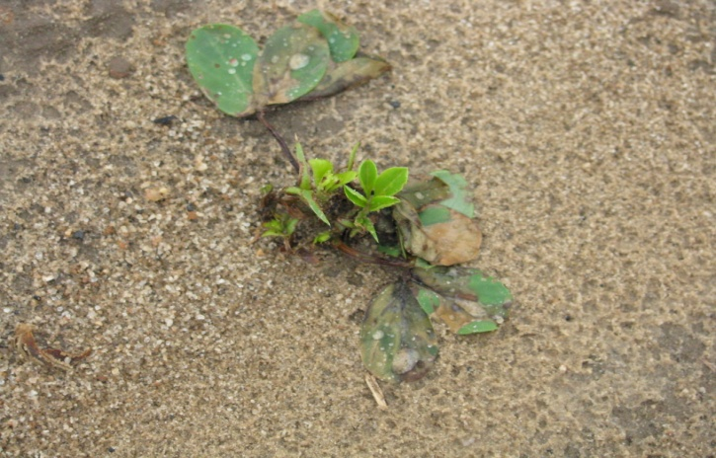
Valor Injury @ (6 oz/A)
16 DAT
PD: May 5
Rainfall Events:
May 5 = 0.04”
May 14 = 0.56”
May 15 = 0.16”
May 16 = 0.01”
May 17 = 0.51”
May 20 = 0.07”
May 21 = 0.59”
May 22 = 0.58”
May 23 = 0.24”
May 24 = 0.13”
May 25 = 0.20”
May 26 = 0.89”
May 28 = 0.05”
June 3 = 0.08”
June 4 = 0.56”
June 5 = 0.77”
30 day rainfall
total from planting = 5.44”
PE-08-09
May 22, 2009

Slide 7
Peanut Yield Response to Valor 51WG - 2009
PE-08-09
Averaged over 3 varieties (GA Green, GA-06G, GA-07W) and 6 replications
Weed-free
LSD 0.10 = 185

Slide 8
Peanut Yield Response to Valor 51WG - 2013
PE-14-13
GA-06G
Averaged over 3 planting dates (April 16, April 29, May 13)
Weed-free
P=0.4015

Slide 9
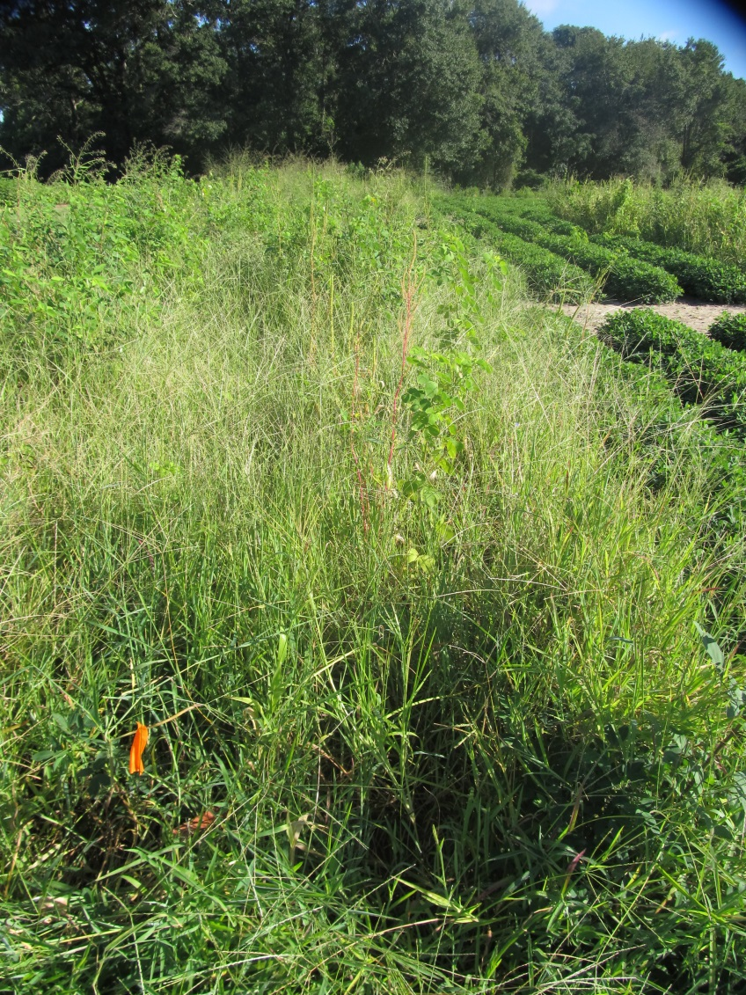
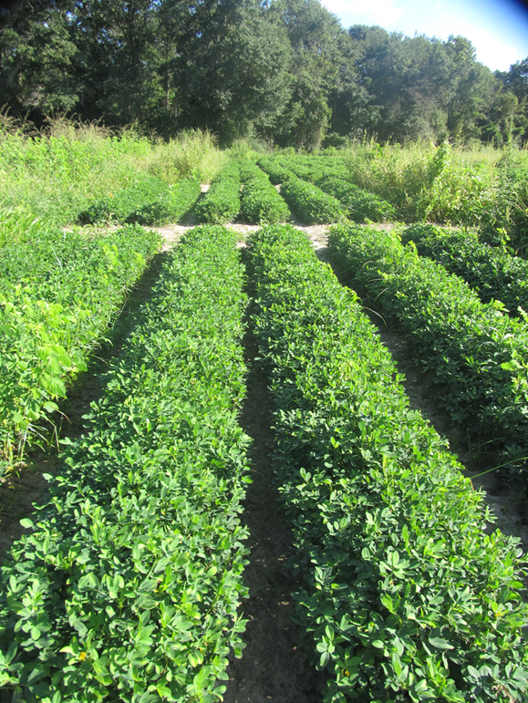
Peanut Weed Control – 2017
Gramoxone/Cadre Program
PE-10-17
August 16
106 DAP
NTC
Prowl H₂0 3.8SC @ 32 oz/A (PRE)
Gramoxone 2SL @ 12 oz/A (15 DAP)
Storm 4SL @ 16 oz/A (15 DAP)
Dual Magnum 7.62EC @ 4 oz/A (15 DAP)
Cadre 2AS @ 4 oz/A (42 DAP)
2,4-DB 1.75SL @ 18 oz/A (42 DAP)
Dual Magnum 7.62EC @ 16 oz/A (42 DAP)

Slide 10
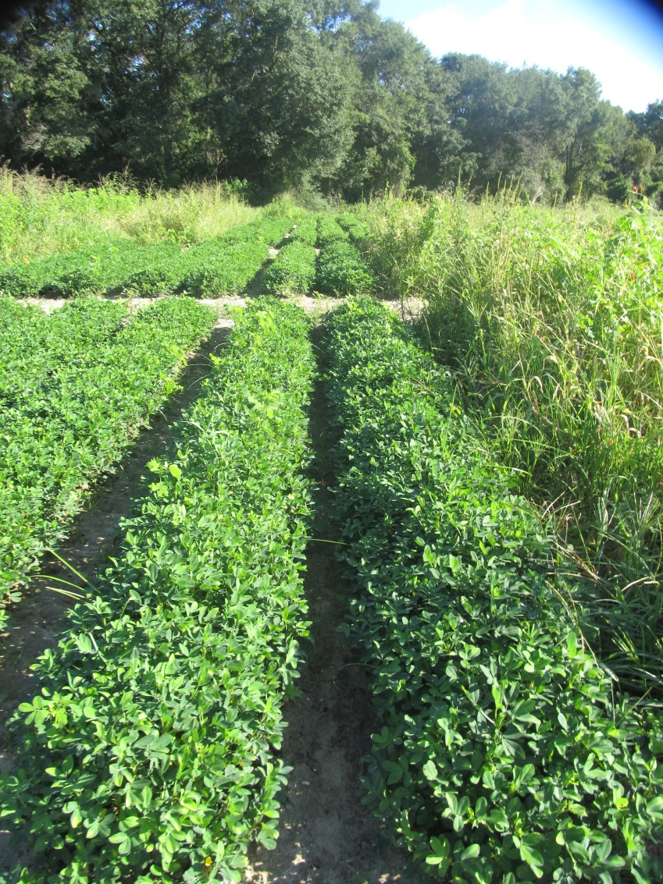
Peanut Weed Control – 2017
Gramoxone/Cobra Program
PE-10-17
August 16
106 DAP
NTC
Prowl H₂0 3.8SC @ 32 oz/A (PRE)
Gramoxone 2SL @ 12 oz/A (15 DAP)
Storm 4SL @ 16 oz/A (15 DAP)
Dual Magnum 7.62EC @ 4 oz/A (15 DAP)
Cobra 2EC @ 12.5 oz/A (42 DAP)
2,4-DB 1.75SL @ 18 oz/A (42 DAP)
Dual Magnum 7.62EC @ 16 oz/A (42 DAP)

Slide 11
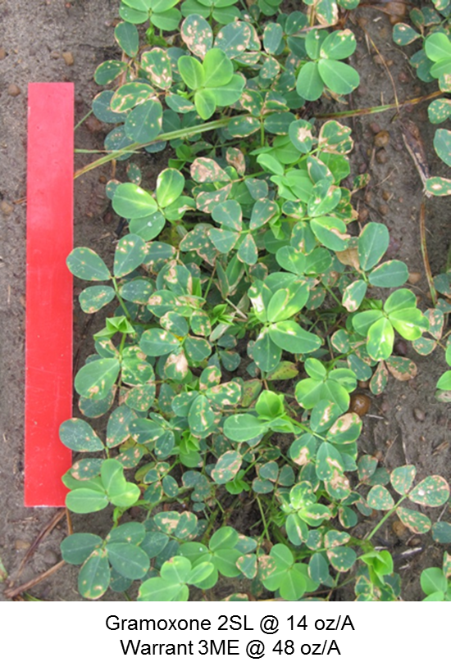


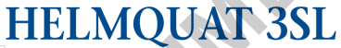
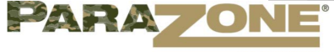
Paraquat Concerns
Using higher paraquat rates without a safener and/or later in the peanut life cycle puts you at more risk for potential yield loss, especially in high yielding irrigated fields or dryland fields!
3 DAT

Slide 12
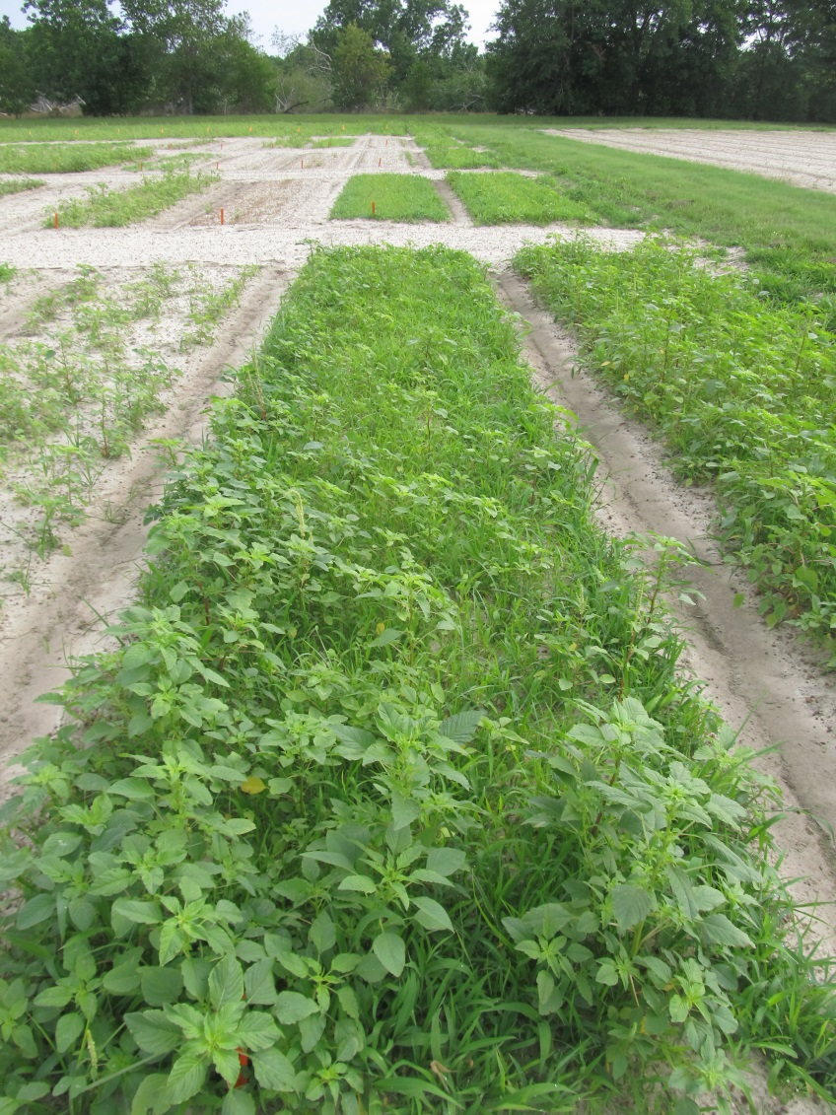
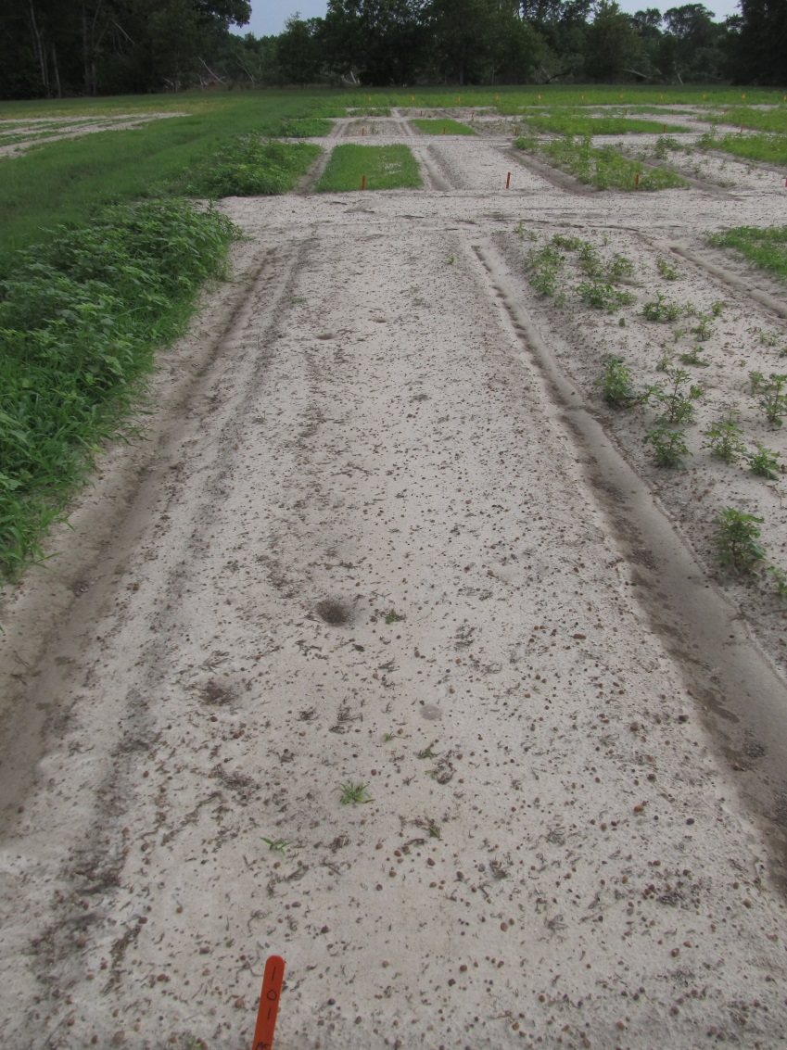
Gramoxone 2SL @ 12 oz/A + Storm 4SL @ 16 oz/A + Dual Magnum 7.62EC @ 16 oz/A – 14 DAT
PE-18-17
May 30
15 GPA
3.5 MPH
11002DG nozzles

Slide 13
A Comparison of Irrigated Weed-Free Peanut Yields Between NTC and Gramoxone 2SL (12 oz/A) + Storm 4SL (16 oz/A) + Dual Magnum 7.62EC (16-21 oz/A) Treatments in Georgia, 2011-2017.
G + S + DM
(lbs/A)
PEA01-11 (GA-06G)
PEA01-12 (GA-06G)
PE-20-11 (GA-06G)
PE-01-12 (GA-06G)
PE-17-12 (GA-06G)
PE-02-13 (GA-06G)
PE-02B-13 (GA-09B)
PE-12-13 (GA-06G)
PE-13-13 (GA-06G)
PE-06-14 (GA-06G)
PE-06-14 (GA-09B)
PE-08-14 (GA-12Y)
PE-15-15 (GA-12Y)
PE-16-15 (GA-13M)
PE-06-16 (GA-12Y)
PE-20-16 (GA-06G)
PE-21-17 (GA-16HO)
IF X = 5000 THEN Y = 4984 (99.7%)
IF X = 6000 THEN Y = 5778 (96.3%)
IF X = 6500 THEN Y = 6176 (95%)
NTC (lbs/A)
n = 82

Slide 14
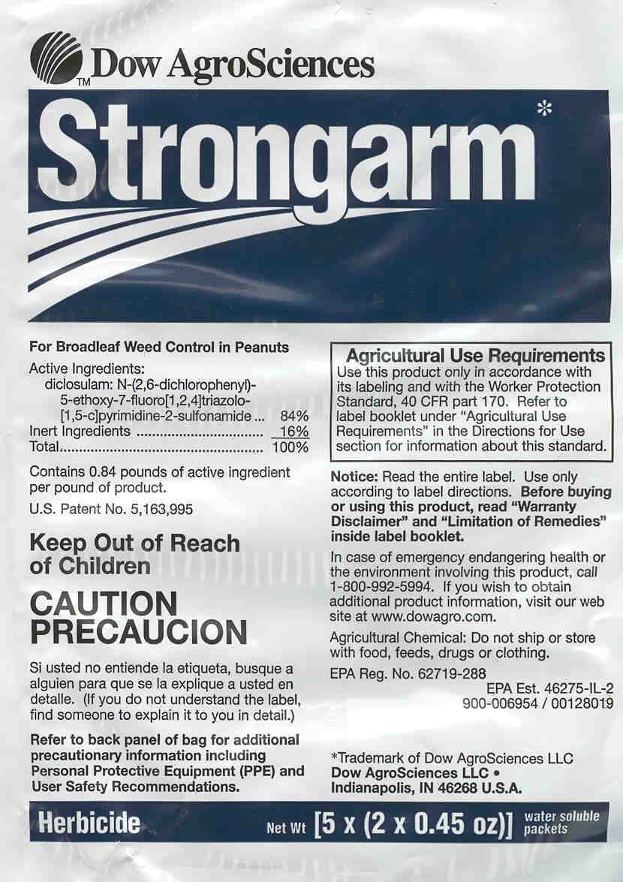

Slide 15
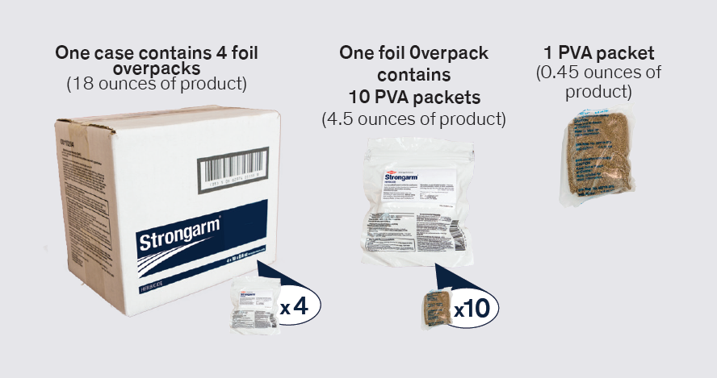
2017 Strongarm Packaging
1 case = 40 acres

Slide 16
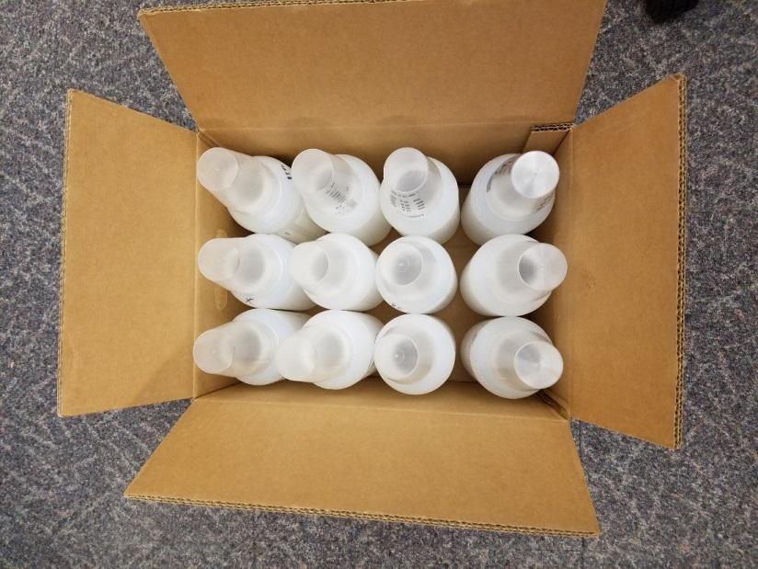
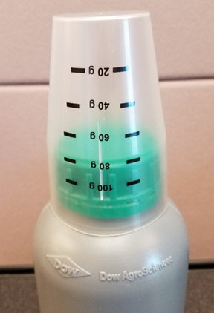
2018 Strongarm Case pack: 12 x 1 lb
Pallet configuration: 1-layer, 10 cases per pallet.
12 x 1 lb case pack using natural bottles
(35.6 acres/bottle)
(426.7 acres/case)
(4267 acres/pallet)

Slide 17

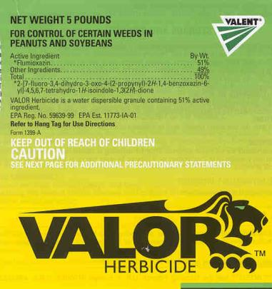

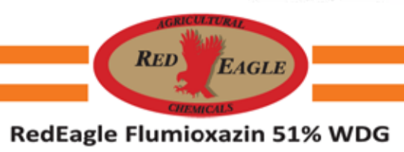



Flumioxazin Formulations

Slide 18
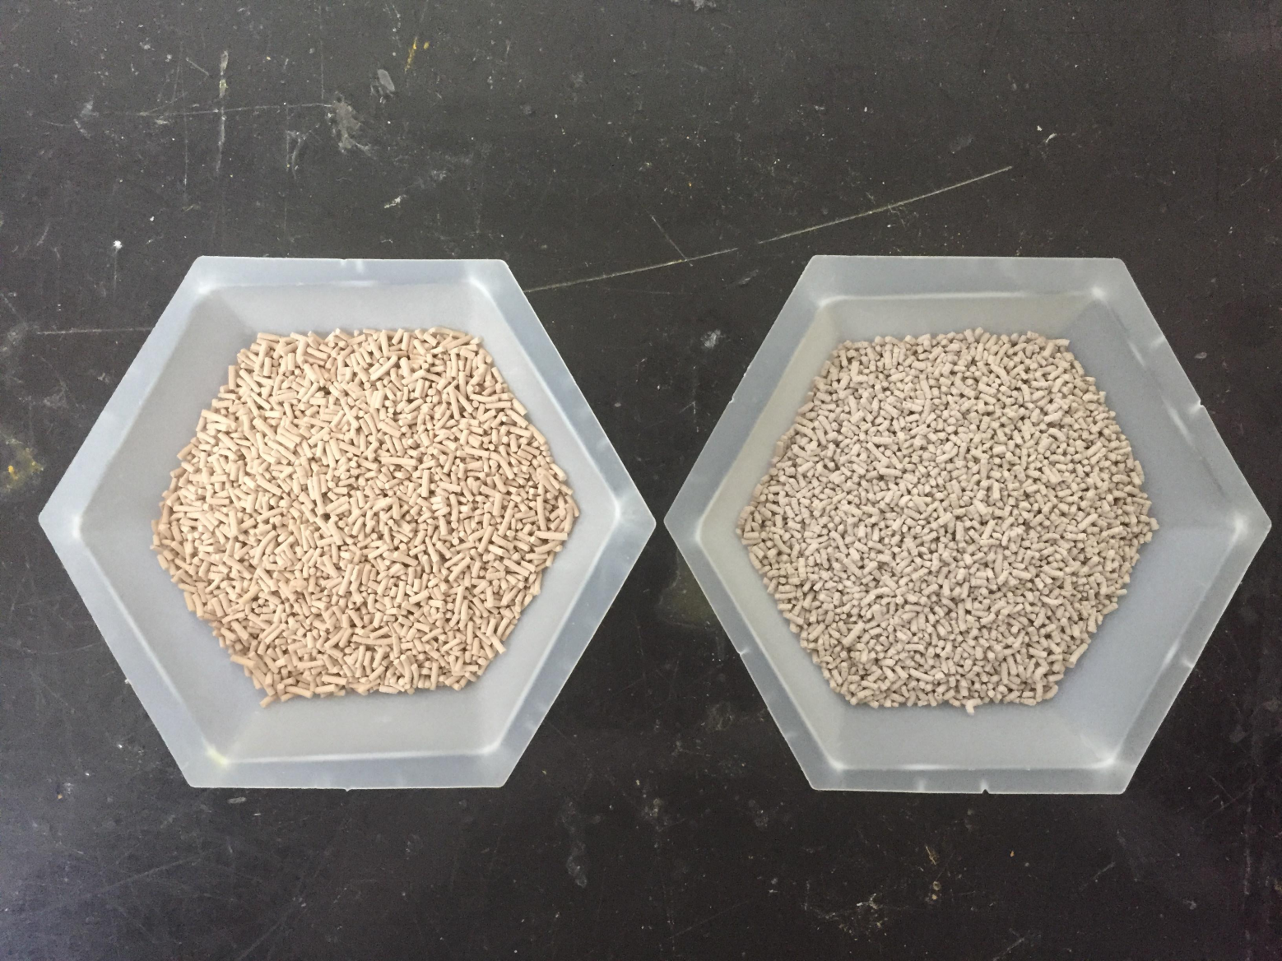
Valor SX vs. Red Eagle Flumioxazin
Valor
Red Eagle
Flumioxazin

Slide 19
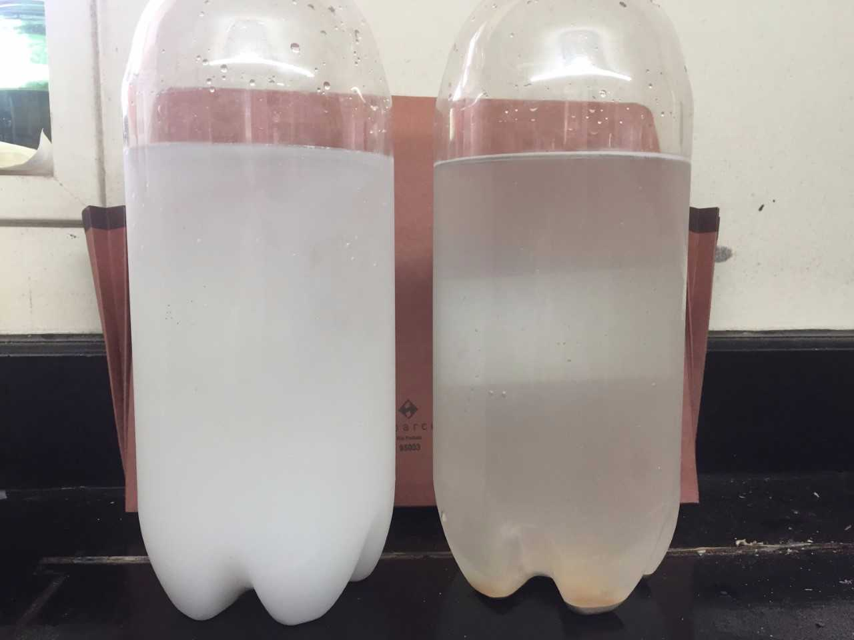
Liquid vs. Dry Flumioxazin

Slide 20
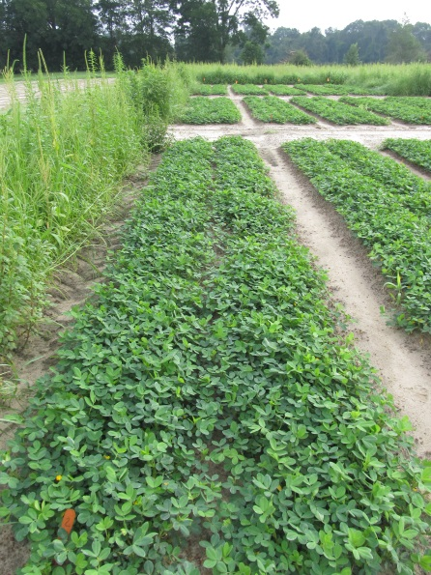
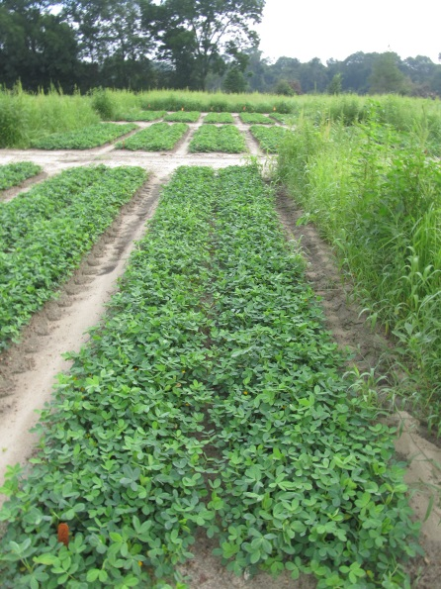


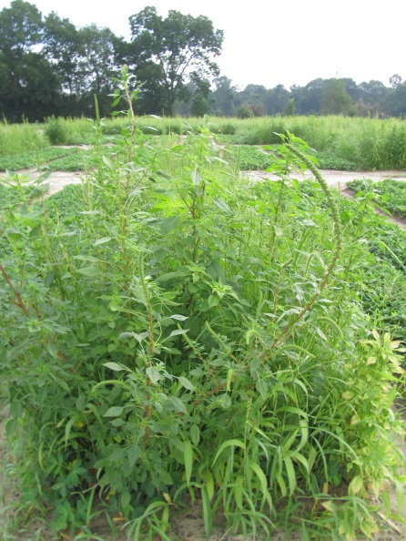

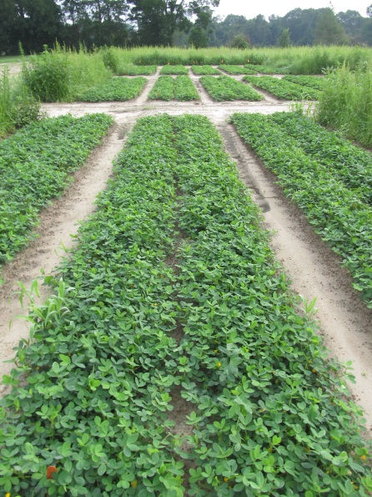
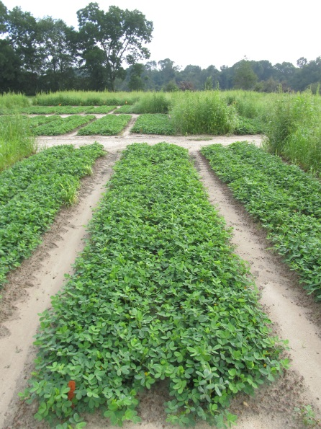


Flumioxazin Formulation Test – 2017
3 oz/A
PE-20A-17
June 28
65 DAP
*All treatments included Prowl H₂O (PRE) fb Cadre + Dual Magnum + 2,4-DB (32 DAP)

Slide 21
Peanut Yield
P = 0.5966

Slide 22
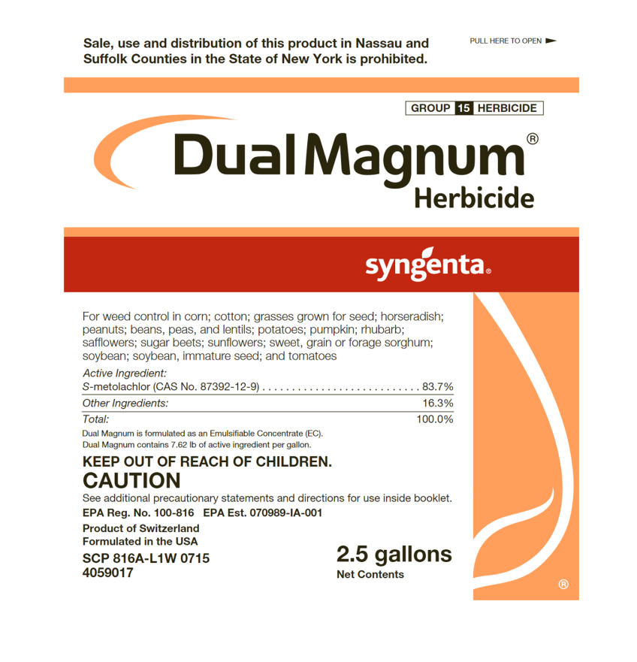
Dual Magnum/High Moisture/Peanuts
Applied PRE under high moisture conditions
Questions?
  Crop injury
  J-rooting
  Yield loss

Slide 23


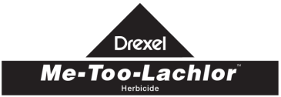
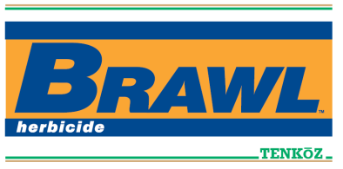
Brief History of Metolachlor
Metolachlor synthesized by Ciba-Geigy in 1972
  50/50% mixture of R + S isomers
Registered for corn in 1977
  Dual 8E
Registered for peanut in 1980 (February)
Ciba + Sandoz = Novartis (1996)
S-metolachlor registered for use in 1997 (Novartis)
  12/88% mix of R + S isomers
    Patent expiration
    EPA Reduced Risk Pesticide Program
    Dual Magnum 7.62EC (+ safener)
Novartis stopped selling “old” metolachlor in 1999, phased out completely by 2001.
  Novartis + AstraZeneca became Syngenta in 2000
Generic companies started producing “old” metolachlor in 2003 (i.e. 50/50 mix of R + S isomer).

Slide 24
Metolachlor/Peanut Research Results
Author (s) | Year | Journal | Results
Cardina and Swann | 1988 | Peanut Sci. 15:57-60 | Emergence and growth delayed from PPI applications when rainfall or irrigation followed application. No effect on yield at labeled rates. 3X rate reduced yield (11-15%)
Wehtje et al. | 1988 | Peanut Sci. 15:53-56 | Across all years, a 2-fold safety factor existed between maximum labeled rate and injury rate.
Johnson et al. | 1993 | Peanut Sci. 20:17-20 | Split applications of metolachlor (PPI + VE) had no effect on yield.
Johnson et al. | 1994 | Peanut Sci. 21:126-129 | PPI, VE, and PPI + VE applications had no effect on yield.
Prostko and Grey | 2011-2012 | unpublished | No effect on yield when applied PPI, PRE or EPOST (4 weed-free trials)

Slide 25
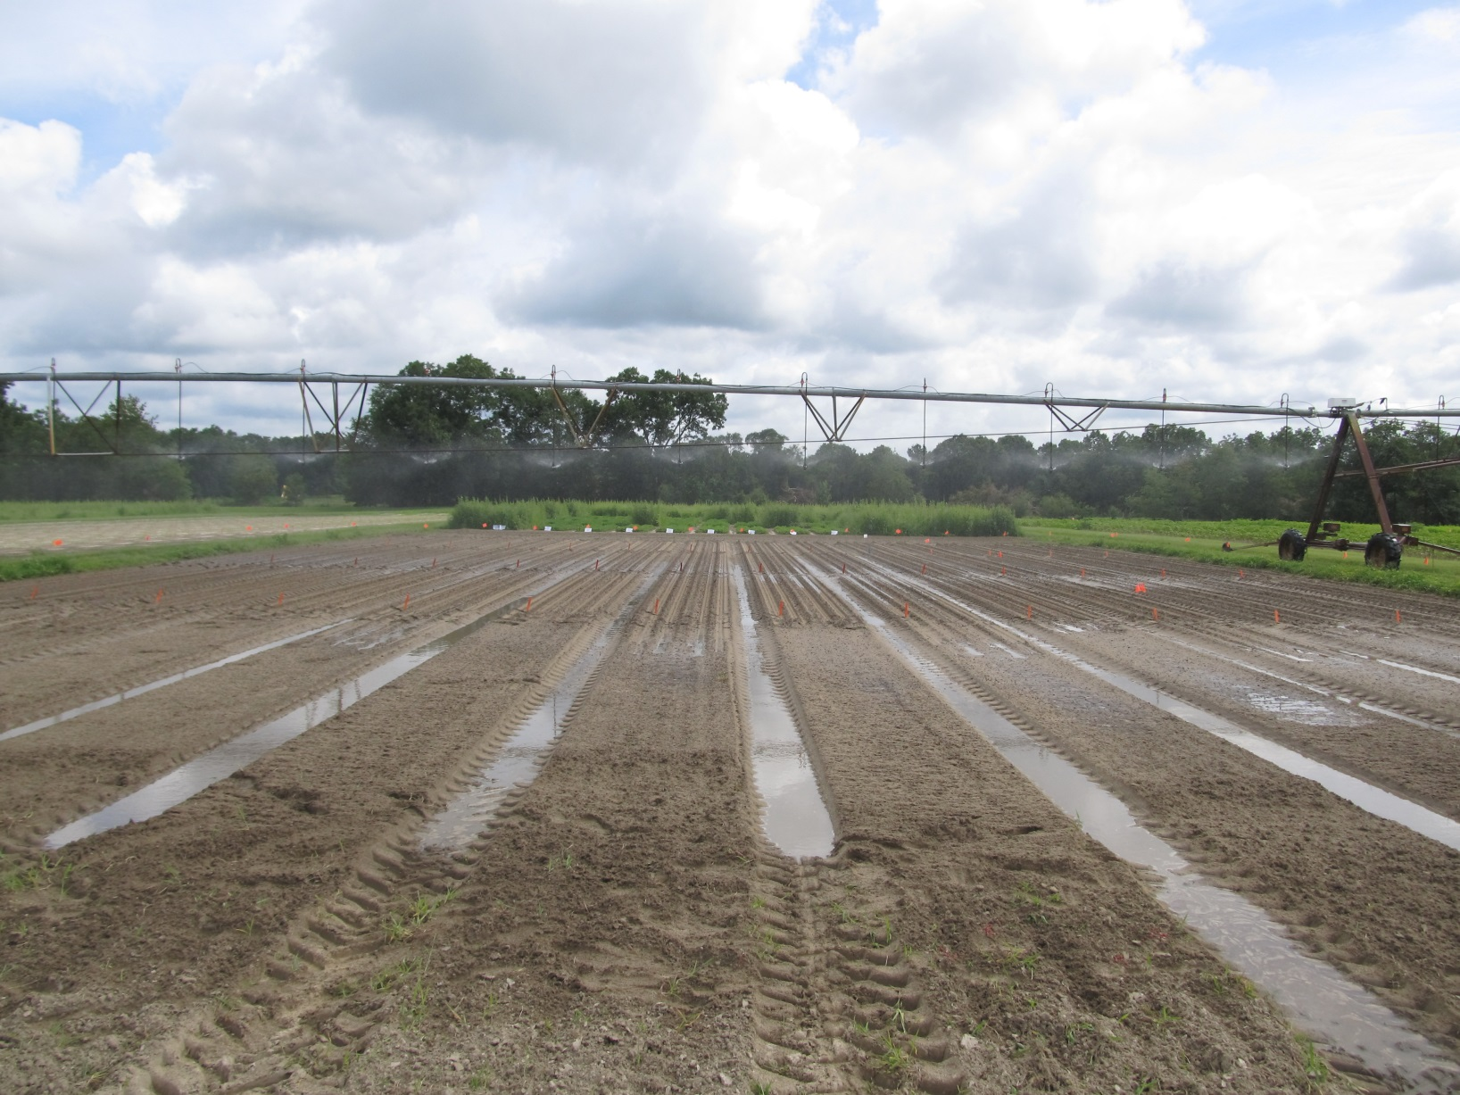
PE-67-17 – June 29 - Irrigation
Planted: June 28
Rainfall/Irrigation:
June 28-July 5 = 4.29”
July 6-12 = 0.375”
July 13-19 = 1.75”
July 20-31 = 2.25”

Slide 26
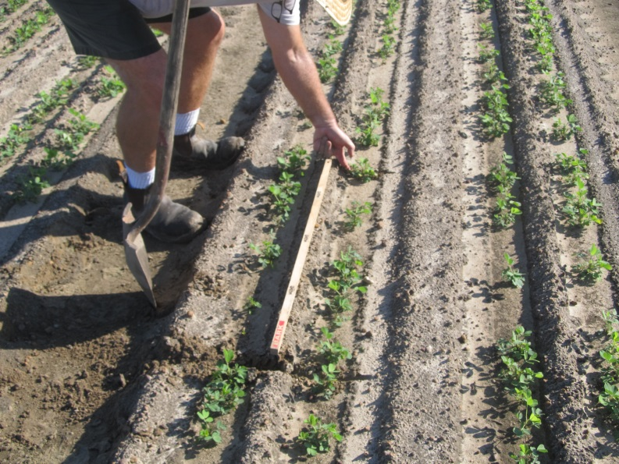
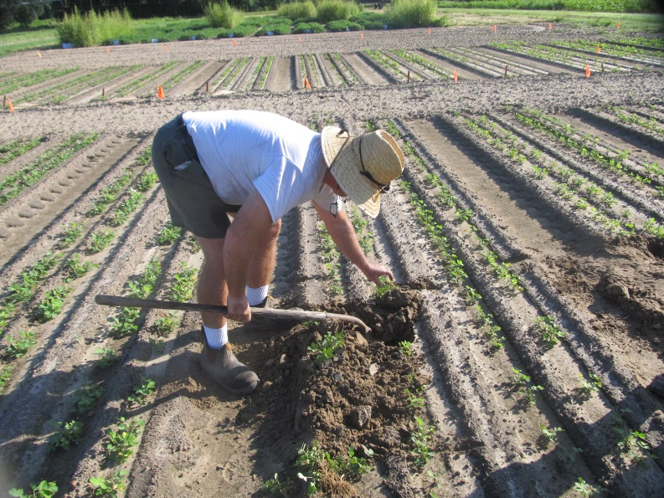
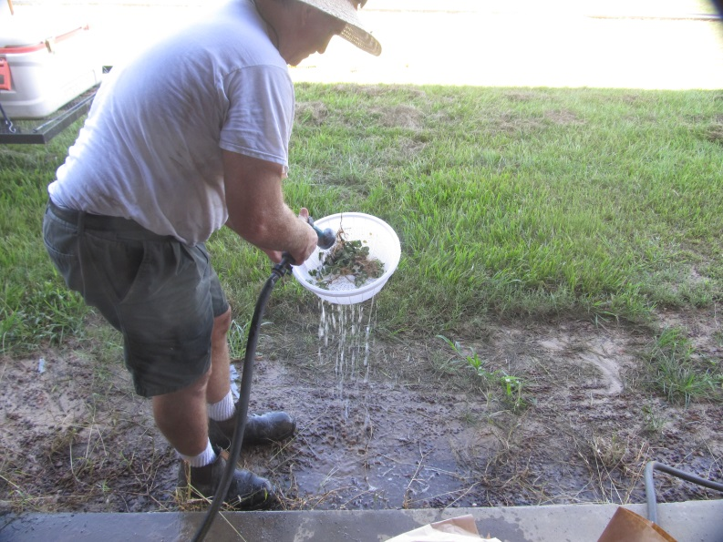
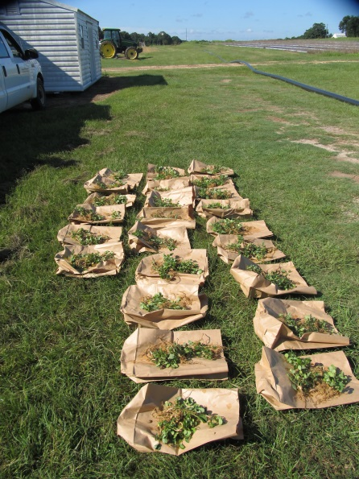
Destructive Harvest – July 19 (21 DAT)

Slide 27
Results
PRE applied Dual Magnum under high moisture conditions (~8.4” rainfall/irrigation within 30 DAP)
  had no effect on peanut emergence, population, or J-rooting
  increased peanut stunting
    21 oz/A = +9-16%
    42 oz/A = +22-25%
  Yield?

Slide 28
Valor and Dual Magnum Effects on Peanut J-Rooting - High Moisture Conditions
P = 0.1215
P = 0.2832
PE-67-17
21 DAT
No interactions
*averaged over 3 Dual Magnum rates
**averaged over 3 Valor rates

Slide 29
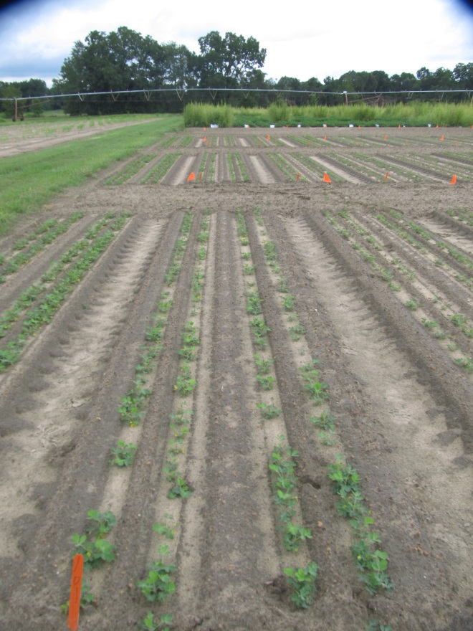
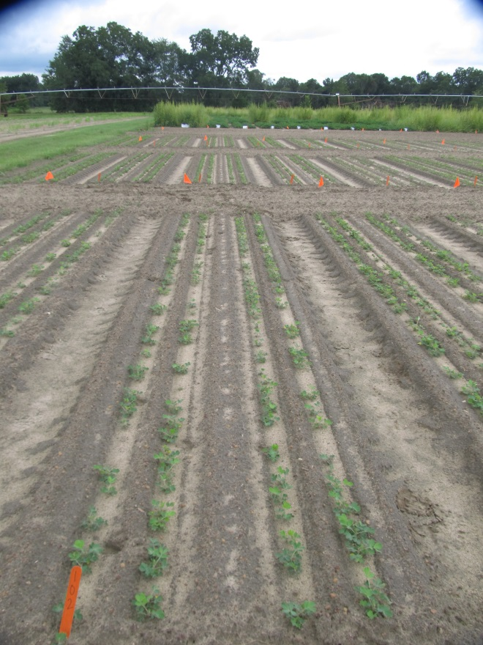
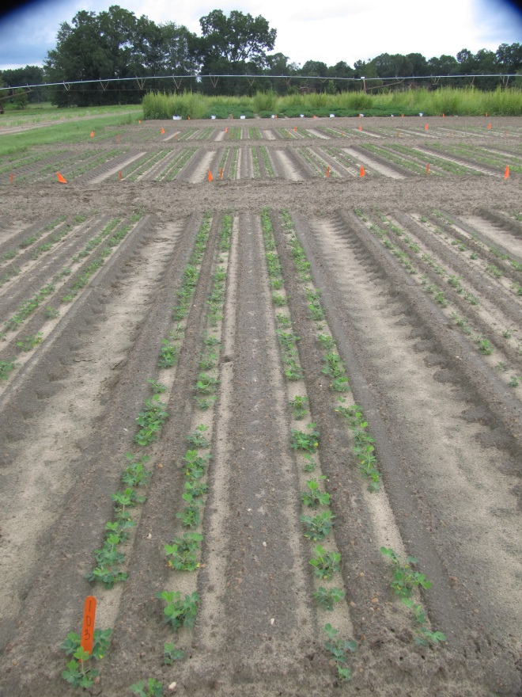
Valor and Dual Magnum Effects on Peanut Plant Stunting - High Moisture Conditions
Valor SX 51 WG @ 3 oz/A
Dual Magnum 7.62EC @ 21 oz/A
Valor SX 51WG @ 3 oz/A
Dual Magnum 7.62EC @ 42 oz/A
Valor SX 51WG @ 3 oz/A
PE-67-17
July 17
19 DAT

Slide 30
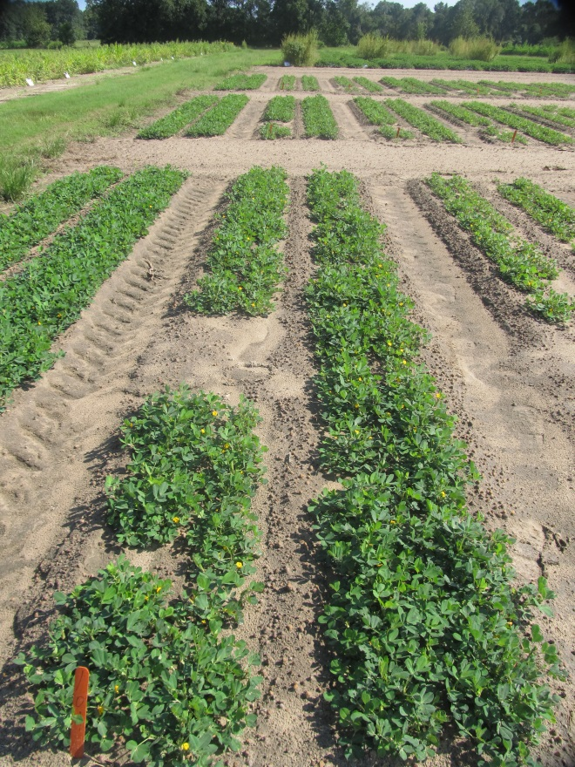
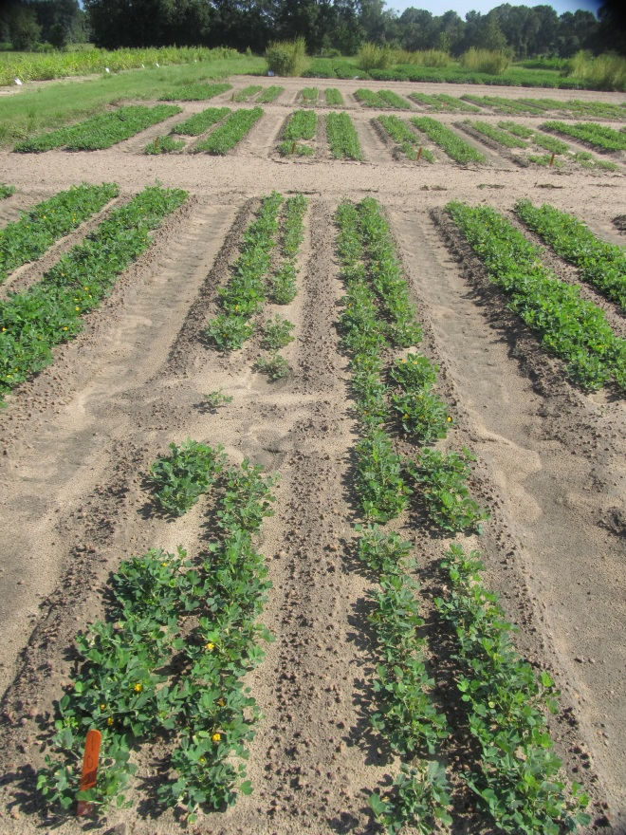
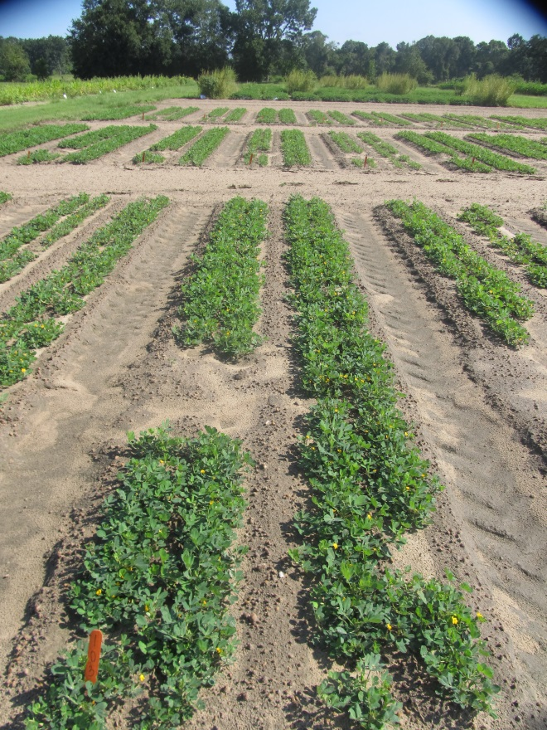
Valor and Dual Magnum Effects on Peanut Plant Stunting - High Moisture Conditions
Valor SX 51 WG @ 3 oz/A
Dual Magnum 7.62EC @ 21 oz/A
Valor SX 51WG @ 3 oz/A
Dual Magnum 7.62EC @ 42 oz/A
Valor SX 51WG @ 3 oz/A
PE-67-17
August 15
48 DAT

Slide 31
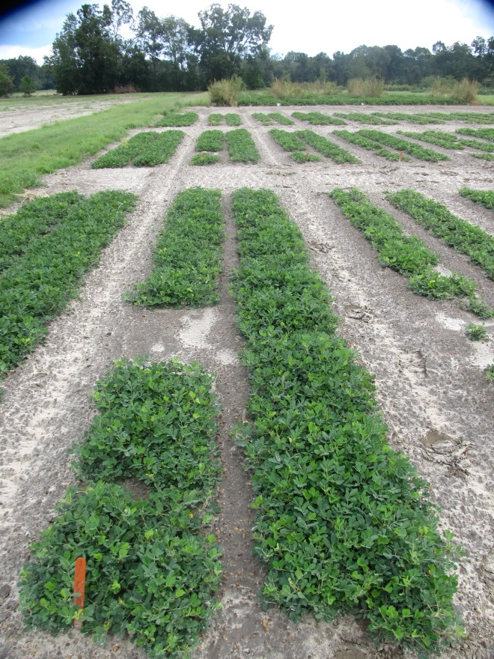
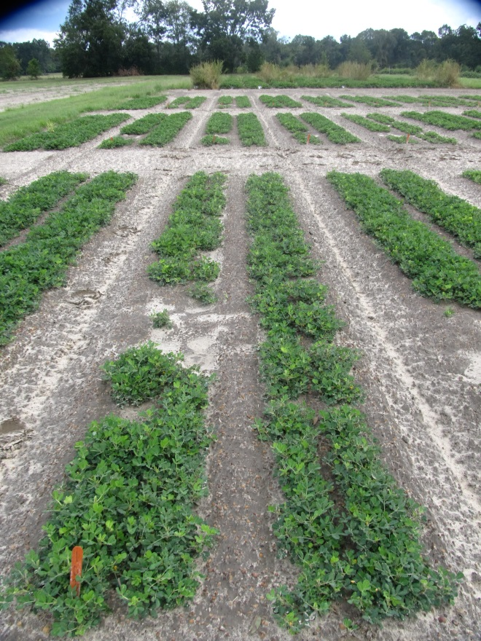
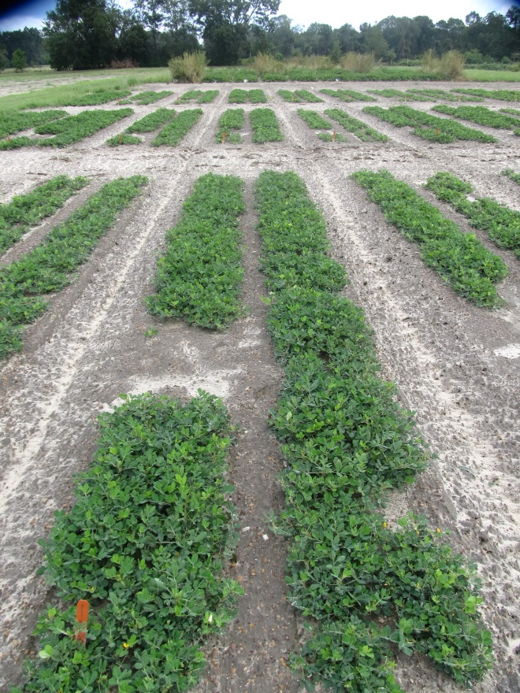
Valor and Dual Magnum Effects on Peanut Plant Stunting - High Moisture Conditions
Valor SX 51 WG @ 3 oz/A
Dual Magnum 7.62EC @ 21 oz/A
Valor SX 51WG @ 3 oz/A
Dual Magnum 7.62EC @ 42 oz/A
Valor SX 51WG @ 3 oz/A
PE-67-17
September 13
77 DAT

Slide 32
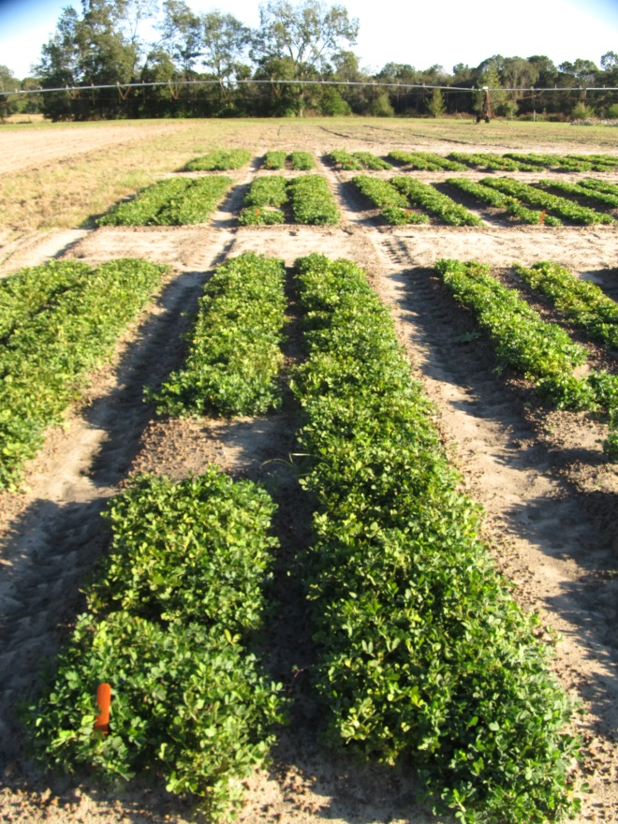
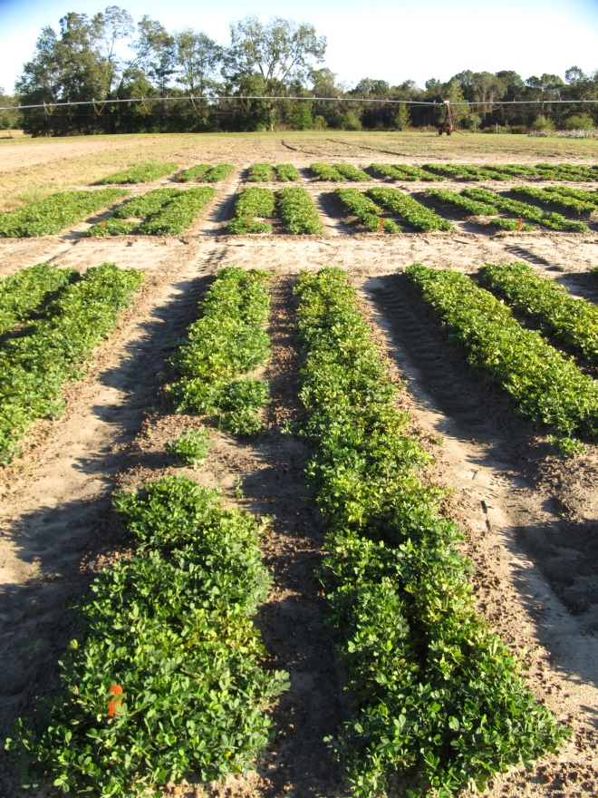
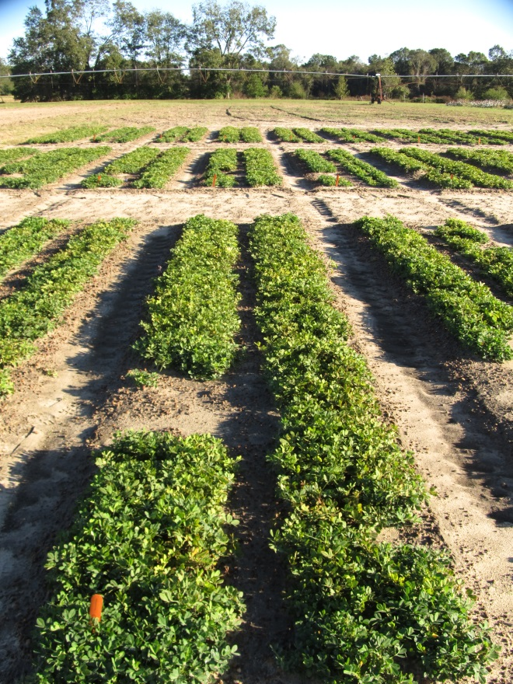
Valor and Dual Magnum Effects on Peanut Plant Stunting - High Moisture Conditions
Valor SX 51 WG @ 3 oz/A
Dual Magnum 7.62EC @ 21 oz/A
Valor SX 51WG @ 3 oz/A
Dual Magnum 7.62EC @ 42 oz/A
Valor SX 51WG @ 3 oz/A
PE-67-17
October 24
118 DAT

Slide 33
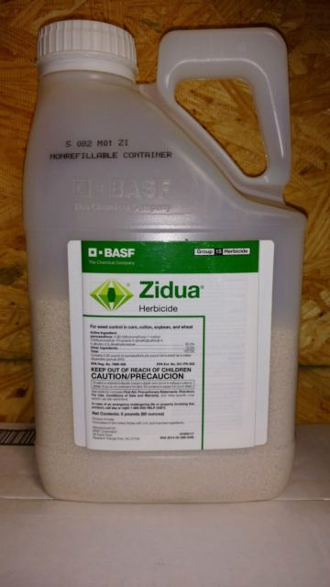

New Stuff
Zidua (pyroxasulfone) gets a peanut label in 2017.
Brake (fluridone) in the pipeline.
Nothing after that???

Slide 34



Zidua vs. Dual in Peanut - 2017
NTC
Prowl H₂O @ 32 oz/A – PRE
Gramoxone 2SL @ 12 oz/A – 154 DAP
Storm SL @ 16 oz/A – 15 DAP
Zidua 85WG @ 2.0 oz/A – 15 DAP
NIS @ 0.25% v/v – 15 DAP
Cadre 2AS @ 4 oz/A – 36 DAP
2,4-DB 1.75SL @ 18 oz/A – 36 DAP
Zidua 85WG @ 2.0 oz/A – 36 DAP
COC @ 1% v/v – 36 DAP
Prowl H₂O @ 32 oz/A – PRE
Gramoxone 2SL @ 12 oz/A – 15 DAP
Storm SL @ 16 oz/A – 15 DAP
Dual Magnum 7.62EC @ 16 oz/A – 15 DAP
Cadre 2AS @ 4 oz/A – 36 DAP
2,4-DB 1.75SL @ 18 oz/A – 36 DAP
Dual Magnum 7.62EC @ 16 oz/A – 36 DAP
PE-10-17
August 16
106 DAP

Slide 35

Brake vs. Valor Programs* - 2017
Valor Program
Brake Program
NTC
Valor Program
Brake Program
NTC
Valor Program
Brake Program
PE-07-17
July 28
94 DAP
*Both programs also included Prowl H₂O (PRE) and Cadre + Dual Magnum + 2,4-DB (36 DAP)

Slide 36

Brake/Peanut Injury
PE-07-17
May 15
20 DAP

Slide 37

Avoid The Oopsies!

Slide 38

Oops!
Applied 60 DAP
15 GPA
11am
Valor 2 oz
Cadre 2 oz
2,4-DB 16 oz
Bravo 16 oz
Pic @ 10 dat

Slide 39




Another Oops!
Not treated
Treated
September 14, 2017
32 DAT (122 DAP)
Tide Hexar 2SL
14.5 oz/A + COC

Slide 40


Glyphosate/Peanut - 2017
Bulloch County
Early County

Slide 41

Dry MnSO₄ + 2,4-DB
Day 1- Mixed in 700-800
Gallons of water – no problems
Day 2 - Mixed in less than 100 gallons of water – Big Mess
Dr. Alan York
NCSU
July 2017

Slide 42


What do the top Georgia peanut growers do?
2016 Georgia Peanut Achievement Club Winners
14 growers
6266 lb/A average yield
  GA State Avg. = 3900 lb/A
14/14 – irrigated (100%)
10/14 - bottom plow (71%)
11/13 - twin rows (85%)
Herbicides
  8/14 – Sonalan (57%)
  12/14 - Valor (86%)
  3/14 - Dual (21%)
  12/14 - Cadre (86%)
  9/14 - 2,4-DB (64%)
  4/14 – Prowl (29%)
  5/14 – Strongarm (36%)

Slide 43

Questions?
eprostko@uga.edu
www.gaweed.com

